Slide 1
Multiagent organizations
-Original Paper by Virginia Dignum and Julian Padget-
Project by DLarisa, 410

Slide 2
Content
1) Introduction
2)Multiagent Organizations
3) Institutions
4) Agents in Organizations
5) Evolution of Organizations

Slide 3
introduction

Slide 4

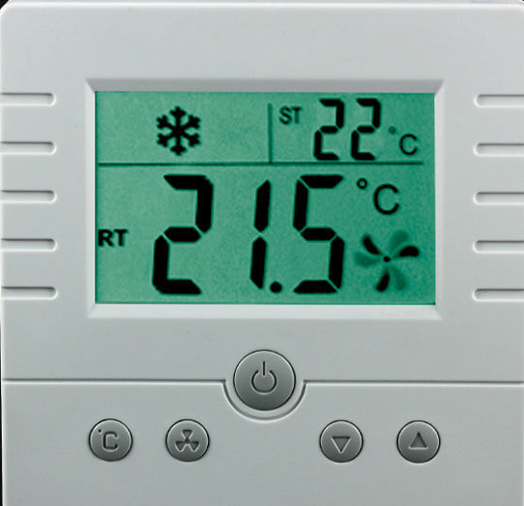
Introduction - agent
Environment
Agent
SMART
Thermostat – Agent
House - Environment

Slide 5
Intelligent agent
Reactivity
Proactiveness
Social Ability
Intelligent Agent
Agent

Slide 6


Do agents need organizations?
YES!
„Teamwork makes the dream work!”
MAS
Multiagent system

Slide 7
Multiagent system
Multiagent system = multiple intelligent agents that interact to solve problems that are beyond the individual capabilities or knowledge of each individual.
Characteristics
1) Each agent has insufficient knowledge or ability to reach the system’s target
2) There isn’t a global control over the agents
3) The obtained data is not centralized

Slide 8
Multiagent System vs multiagent Organization
Multiagent system:
Agents „encapsulate” the organization (agents assume the goals of the organization)
Extern agents cannot enter the system
Hard to maintain, revise, scale up
Multiagent organization:
Organization is an entity in itself (agents have their own unique goals)
Extern agents can enter the organization if there is a mutual profitable relationship
Better adaptability

Slide 9
From agent’s perspective, organizations:
From mas’ perspective, organizations:
ensure a better integration of the agents in the system, in order to better adapt themselves to change
Delegation of tasks/beliefs between the agents
ensure global behavior at the MAS level in order To be sure that the global goals of the system are achieved
represent observed patterns of interaction

Slide 10
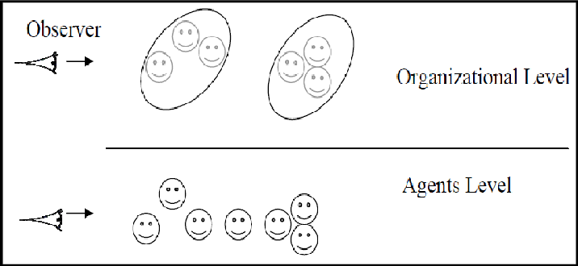
Conflict of interest

Slide 11
REGULATION
AUTONOMY
„Do it like this!”
Regulated, or directed, behavior
Do not consider diferences in individual capabilities
Strict obedience to rules often does not get work done
„Do it however you feel like it!”
Ability to make decisions about own activity
Individual rationality is insuficient to deal with social behavior

Slide 12
Regulation and autonomy
Can we have both?
Combination of individual rationality with laws of social interaction.
Internal autonomy:
Specify organization independently from the internal design of the agent
Enables open systems
heterogeneous participation
Collaboration autonomy:
Specify organizations without fixing a priori all structures, interactions and protocols
Enables evolving societies
Balances organizational needs and agent autonomy
Multiagent Organization
Regulation
Internal Autonomy
Autonomy
Collaboration Autonomy

Slide 13
Multiagent organizations

Slide 14
definition
organizations describe objectives, roles, interactions, and rules in an environment without considering the particular characteristics of the individuals involved.
Is an entity in itself, separately from its agents

Slide 15
components
Entities (e.g. roles, sub-groups, positions, agents...): they represent the population of the organization, the elements that, at a higher level, could be characterized as dynamic, because they „do”/„act” something/in some way. They are independent, expected to be intelligent/rational and gifted with some type of skills;
Relationships (e.g. coordination, negotiation, cooperation...): the organization is expected to establish order among its entities and draw the relationships between them, to the purpose of accomplishing a greater goal that exceeds one individual skill alone, as it is the responsibility of the multiagent organization to achieve the global objective. Some possible relations: delegation of tasks, access to different resources, synchronization of actions, transfer of useful informations...;
Goals (intentions, targets): as mentioned above, the organizational goal is not implicitly the ambition of its agents, so a global strategy is required, using local decisions;
Norms (rules, patterns): are imposed by the organization and can be divided into 2 (the organization must balance control and efficiency – design choice):
o Constraints: not flexible, cannot be disobeyed;
o Regulations: flexible, the agent can decide what course of action should follow.
Environment: it’s the space the organization inhabits. The relationship between organization and environment is bidirectional, as the environment influences the decisions made by the system and those choices affect the environment. Most environments are:
o Dynamic: meaning that agents can evolve, their behaviours and actions can change, the environment responds to the organization’s activity or has external influences etc...
o Open: the information is shared between entities, distributed management, organization’s components are not supervised by only one entity etc..

Slide 16
Multiagent organizations
As Structures
OperA Framework
As Institutions
InstAL Framework

Slide 17
Requirements of organization model - structure
Reflect and Support Organizational Design
Specify interaction independently from the internal design of the agent
Balance organizational design and agent autonomy

Slide 18
institutions

Slide 19
institutions
Institutions facilitate and enforce the normative character of organizations
Determine interaction and communication forms within the organization
Connect organizational and individual perspectives
Make explicit the social norms governing behaviour, external to the agents

Slide 20
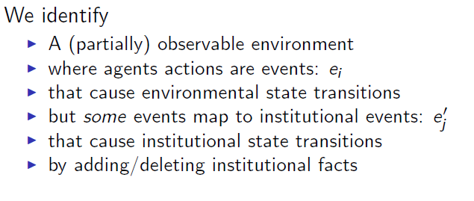
An informal model

Slide 21
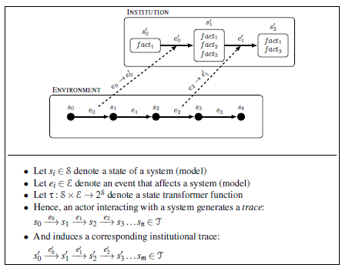
An informal model

Slide 22
Constraints on action
Obligation
An actor must take actions resulting in a particular institutional state that satisfies the obligation.
Permission
Indicates whether some action is permitted for some actor in the current state of the institution.
Power
Indicates whether some action by some actor has an effect on the institutional state.

Slide 23
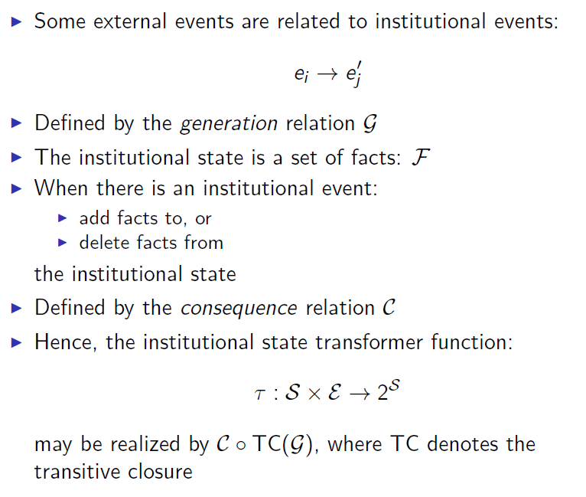
Event mapping and state changing

Slide 24
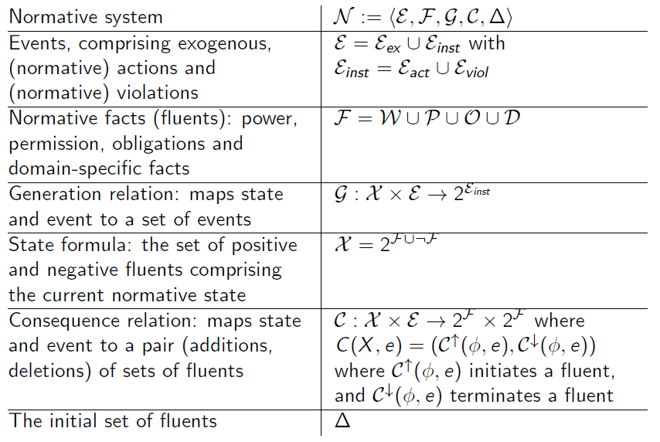
A formal model

Slide 25
Agents in organizations

Slide 26
Agents and organizations
Agents -> Autonomy
Agents are motivated by their own objectives, beliefs.
May take up organizational role if it serves their purposes
Organization -> Regulation
Organizations (too) have their own purpose
Exist independently of the agents populating it

Slide 27
Role vs Agent
Agent:
Is capable of flexible, autonomous action in order to meet its design objectives;
Agents act, roles not.
Role:
Abstract representation of a function, service or identification within a group/society;
Desired activity and behavior from society perspective.

Slide 28
Role enacting agents
The ability to reason about which of its plans and activities can be used to achieve role objectives.
The ability to execute functions defined by the role or imposed by role relationships, including the ability to use resources available to the role.
The ability to communicate with players of other roles as a representative of its own role.

Slide 29
Role enactment style
- Selfish Style: agents give priority to as many as possible of their own goals and rules over the interest of the organization;
- Social Style: the agent will give priority to the objectives and rules of the role and try to include as many of their own targets and norms as possible;
- Maximal Social Style: the entity prioritizes the assignments and rules of the role.

Slide 30
Evolution of organizations

Slide 31
Evolution of organizations
Objective for organization: provide stability
External Stimulus: environment mutability;
Internal stimulus: modified strategies, agents, interactions...
Reorganize if utility increases afterwards!

Slide 32
Questions?

